Slide 1



Full Stack Development With AI
Introduction to ANN
Saturday, Feb 14, 2026
09.30 AM SGT

Slide 2
Introduction to ANN

Slide 3
Agenda
Artificial Neural Network
Neuron in ANN
Activation Functions
Single Layer NN
Multi Layer NN

Slide 4
Artificial Neural Network
Artificial Neural Networks (ANNs) are computer systems designed to mimic how the human brain processes information.
These networks consist of layers of interconnected neurons that work together to solve complex problems

Slide 5
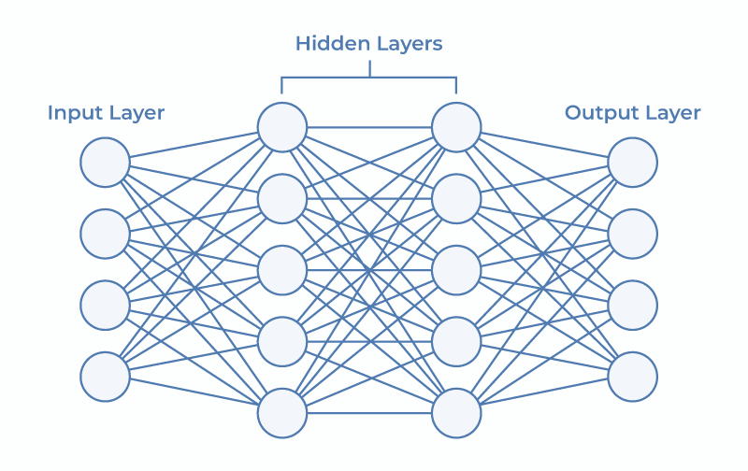
Neural Network

Slide 6
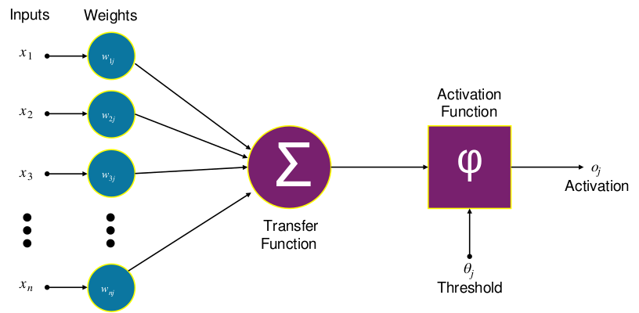
Artificial Neural Network

Slide 7
Terminologies
Term | Definition
Neuron (or Node) | The basic processing unit of an ANN, analogous to a biological neuron. It receives inputs, processes them, and passes the result (output) to the next layer.
Layer | A collection of neurons organized together. ANNs typically have three types of layers: Input Layer, Hidden Layer(s), and Output Layer.
Input Layer | The first layer of the network; it receives the raw data input.

Slide 8
Terminologies
Term | Definition
Hidden Layer | Layers between the input and output layers where the bulk of the computation happens. A network with more than one hidden layer is considered a Deep Neural Network.
Output Layer | The final layer of the network that produces the final prediction or result.
Weight ($w$) | A parameter associated with each connection between neurons. It determines the strength or influence of one neuron's output on the next neuron's input. Weights are adjusted during training.

Slide 9
Terminologies
Term | Definition
Bias ($b$) | A constant value added to the weighted sum of inputs in a neuron, allowing the activation function to shift and better fit the data. It's also a trainable parameter.
Activation Function | A mathematical function applied to the weighted sum of inputs plus the bias ($\sum w_i x_i + b$) to determine the neuron's output. It introduces non-linearity to the network, allowing it to learn complex patterns. Common examples include ReLU, Sigmoid, and Softmax.
Perceptron | The simplest type of feedforward ANN, a single neuron that takes multiple inputs and produces a single output.
Dense Layer | A layer where every neuron is connected to every neuron in the preceding and succeeding layers.

Slide 10
Terminologies
Term | Definition
Forward Propagation (or Forward Pass) | The process where input data is passed through the network, layer by layer, to compute an output prediction.
Cost Function (or Loss Function or Objective Function) | A function that quantifies the difference (error) between the network's predicted output and the actual target value. The goal of training is to minimize this function. Common examples are Mean Squared Error and Cross-Entropy.
Backpropagation (or Backward Pass) | The core algorithm for training ANNs. It calculates the gradient (the partial derivatives of the loss function with respect to the weights and biases) and propagates the error backward from the output layer to adjust the weights.

Slide 11
Terminologies
Term | Definition
Gradient Descent | An iterative optimization algorithm used to minimize the loss function by adjusting the weights and biases in the direction of the steepest descent of the gradient.
Learning Rate ($\alpha$) | A hyperparameter that controls the step size taken during gradient descent. A high learning rate can speed up training but risk overshooting the minimum; a low learning rate is slower but more precise.
Epoch | One complete pass of the entire training dataset through the neural network (both forward and backward passes).

Slide 12
Terminologies
Term | Definition
Batch Size | The number of training examples utilized in one iteration of the weight update. Stochastic Gradient Descent (SGD) often uses a batch size of 1, while Mini-Batch Gradient Descent uses a small subset (e.g., 32 or 64).
Hyperparameter | A parameter whose value is set before the training process begins, as opposed to a parameter (like weights and biases) that is learned during training. Examples include learning rate, number of hidden layers, and batch size.
Overfitting | A phenomenon where the model performs exceptionally well on the training data but poorly on unseen data because it has learned noise or irrelevant details specific to the training set.
Regularization | Techniques (like L1/L2 regularization or Dropout) used to prevent overfitting by adding a penalty to the loss function based on the size of the weights.

Slide 13
Activation Functions
An activation function in a neural network is a mathematical function applied to the output of a neuron.
It introduces non-linearity, enabling the model to learn and represent complex data patterns.

Slide 14
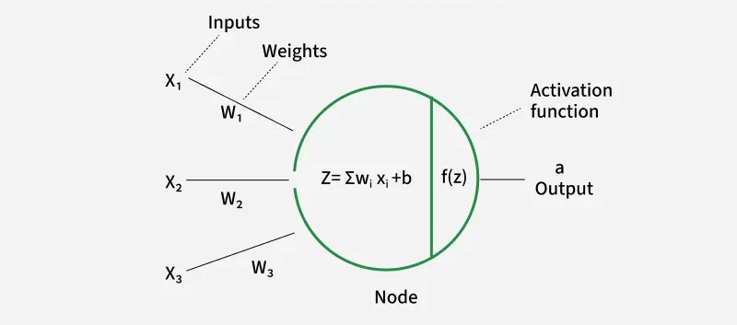
Activation Functions

Slide 15
Activation Functions
Linear Activation Function
Linear Activation Function resembles straight line define by y=x. No matter how many layers the neural network contains if they all use linear activation functions the output is a linear combination of the input.

Slide 16
Non Linear Activation Functions
Sigmoid
TanH
ReLU

Slide 17
Sigmoid
Characterized by ‘S’ Shape
Ensures a smooth & continuous output
Good for gradient based optimization methods
Output range between 0 & 1
Exhibits a steep gradient when x values are between -2 & 2

Slide 18

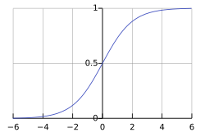
Sigmoid

Slide 19
Tanh Function
A shifted Sigmoid Function
Stretches across y axis
Output values from -1 to 1
Enables modeling of complex patterns
Commonly used in hidden layers

Slide 20
ReLU Activation Function
If the input x is positive, returns x.
If the input is negative, returns 0
Good for hidden layers
Value range between 0 & infinity
Less computationally expensive

Slide 21
Exponential Activation Functions
SoftMax Function
SoftPlus Function

Slide 22
SoftMax activation
Handles multiclass classification
Transforms raw output scores to network of probabilities
Squashes output to a range between 0 and 1

Slide 23
SoftPlus activation
Similar to ReLU but without hard threshold
Converts to range between 0 & infinity

Slide 24
Demonstration

Slide 25
References
Why Scaling is necessary
Notebook

Slide 26

LIVE SESSION EXPERIENCE SURVEY
Before we proceed to Q&A
Take 2 minutes to share your feedback with Us!

Slide 27
THANK YOU

